Slide 1
Module III
Transaction Management and Concurrency Control

Slide 2
Transaction
Instance of buying or selling something.
It contain many parts.
All parts of a transaction must be successfully completed to prevent data integrity problems.
When many transactions take place at the same time, they are called concurrent transactions.
Managing the execution of such transactions is called concurrency control.

Slide 3
i. Evaluating Transaction Results
To examine the current balance for customer number 10016 located in the CUSTOMER table. Such a transaction can be completed by using the SQL code:
    SELECT CUST_NUMBER, CUST_BALANCE
    FROM CUSTOMER
    WHERE CUST_NUMBER= 10016;

Slide 4
The SQL code represents a transaction because it accesses the database.
A transaction may consist of a single SQL statement or a collection of related SQL statements.

Slide 5
ii. Transaction Properties
All transactions must display
  Atomicity
  Consistency
  Isolation
  Durability
  Serialisability.

Slide 6
Atomicity
It requires that all operations (SQL requests) of a transaction be completed; if not, the transaction is aborted.
If a transaction T1 has four SQL requests, all four requests must be successfully completed; otherwise, the entire transaction is aborted.
A transaction is treated as a single, indivisible, logical unit of work.

Slide 7
Consistency
It indicates the permanence of the databases consistent state.
A transaction takes a database from one consistent state to another.
When a transaction is completed, the database reaches a consistent state. If any of the transaction parts violates an integrity constraint, the entire transaction is aborted

Slide 8
Isolation
It means that the data used during the execution of a transaction cannot be used by a second transaction until the first one is completed.
If a transaction T1 is being executed and is using the data item X, that data item cannot be accessed by any other transaction(T2 ... Tn) until T1 ends.
This property is particularly useful in multi-user database environments because several different users can access and update the database at the same time.

Slide 9
Durability
It ensures that once transaction changes are done (committed), they cannot be undone or lost, even in the event of a system failure.

Slide 10
Serialisability
It ensures that the concurrent execution of several transactions yields consistent results.
The concurrent execution of transactions T1, T2 and T3 yields results that appear to have been executed in serial order.
This property is important in multi-user and distributed databases, where multiple transactions are likely to be executed concurrently.

Slide 11
Both single-user database system and the multi-user DBMS should ensure atomicity, the durability of transactions, serialisability and isolation of the database.

Slide 12
iii. Transaction Management with SQL
Transaction support is provided by two SQL statements: COMMIT and ROLLBACK.
ANSI standards require that, when a transaction sequence is initiated by a user or an application program, the sequence must continue through all succeeding SQL statements until one of the following four events occurs:

Slide 13
A COMMIT statement is reached, in which case all changes are permanently recorded within the database. The COMMIT statement automatically ends the SQL transaction.
A ROLLBACK statement is reached, in which case all changes are aborted and the database is rolled back to its previous consistent state.

Slide 14
3. The end of a program is successfully reached, in which case all changes are permanently recorded within the database. This action is equivalent to COMMIT.
4 .The program is abnormally terminated, in which case the changes made in the database are aborted and the database is rolled back to its previous consistent state. This action is equivalent to ROLLBACK.

Slide 15
Example:
  UPDATE PRODUCT
  SET PROD_QOH= PROD_QOH- 2
  WHERE PROD_CODE = '1558-QW1';
  COMMIT;

Slide 16
Good programming practice include the COMMIT statement at the end of a transaction declaration.
SQL Server use transaction management statements such as:
      BEGIN TRANSACTION;
to indicate the beginning of a new transaction.
The Oracle RDBMS uses the SET TRANSACTION statement to declare a new transaction start and its properties.

Slide 17
iv. The Transaction Log
Its used to keep track of all transactions that update the database.
This information in log is used by the DBMS for
  recovery requirement triggered by a ROLLBACK statement
  programs abnormal termination
  system failure such as a network discrepancy or a disk crash.
RDBMSs use the transaction log to recover a database forward to a currently consistent state

Slide 18
The transaction log stores:
A record for the beginning of the transaction
For each transaction component (SQL statement):
  The type of operation (update, delete, insert)
  The names of the objects affected by the transaction (the name of the table)
  The before and after values for the fields being updated
  Pointers to the previous and next transaction log entries for the same transaction
  The ending (COMMIT) of the transaction.

Slide 19
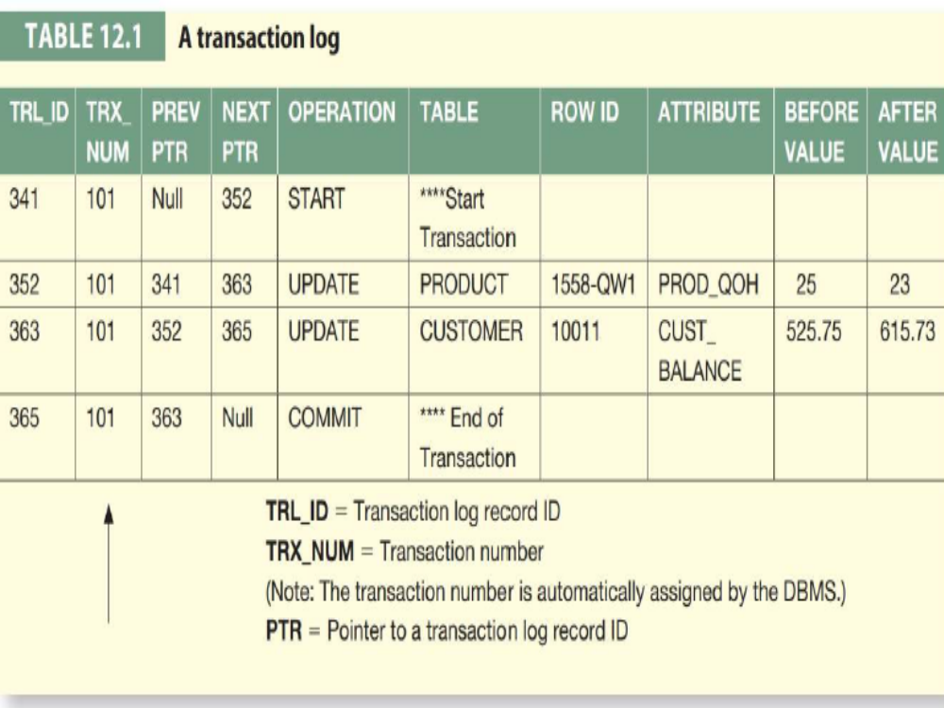

Slide 20
In Case of System Failure?
  The DBMS will examine the transaction log for all uncommitted or incomplete transactions
  Restore (ROLLBACK) the database to its previous state on the basis of that information.

Slide 21
If a ROLLBACK is issued before the termination of a transaction?
  The DBMS will restore the database only for that particular transaction
  To maintain the durability of the previous transactions.

Slide 22
Committed transactions are not rolled back.
The transaction log is itself a database
It is managed by the DBMS like any other database.
The transaction log is subject to common database dangers such as disk-full conditions and disk crashes.

